Slide 1
Life School Response to Intervention 101
Stephanie Wolf, Special Education Manager
Kendra Mason, Mathematics Coordinator
Amanda Phillips, Reading/Language Arts Coordinator

Slide 2
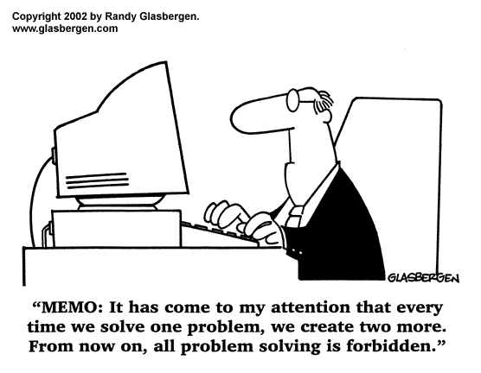

Slide 3
A student’s lack of progress (gaps in learning) is a problem! Do you agree or disagree?

Slide 4

Some say……

Slide 5

& others say……

Slide 6

& if you see student gaps as a problem then…..

Slide 7
Let’s first take a look at what RTI is & what it is not….

Slide 8
Life School RTI Core Beliefs
With appropriate support, teachers can assist a wide range of hard-to-teach students to achieve improved performance.
An intervention must be implemented, monitored, reviewed, and changed as necessary to judge its efficacy.
No important decisions (in RTI) can be made without supporting data.
Implement interventions with fidelity-implementing the RTI plan determined by the RTI committee with integrity is vital for effective decision-making to happen at RTI meetings.

Slide 9
Life School Goals for the RTI Process
INTEGRATION!
Integrate as many instructional systems into one (intervention, small groups, enhancement, etc.)
TEAM-COLLABORATION!
Involve instructional staff in the RTI process
Distribute responsibilities to more than one person
REDUCE PAPERWORK & FILES!
Make forms available in Eduphoria
USE MULTIPLE DATA SOURCES TO DETERMINE STUDENTS IN NEED OF TIER 2 & TIER 3 INTERVENTION!
RTI Indicator Spreadsheet

Slide 10
RTI is….
RTI is not….
An education support for all students
A standardized procedure that guides data collection, analysis, development of interventions, and monitoring of student progress
A structured problem-solving process with follow up (team leaders and teachers) so no student is left behind
Only made available to students in need of an evaluation
A pathway to special education
Limited to a specific duration of time (the student has been in RTI already for a semester/year/etc and now needs…)
An unstructured system that documents student progress on many different skills with lots of attempted interventions

Slide 11
The Paradigm Shift

Slide 12
We are moving from…..
ELIGIBILITY as the focus -Diagnose and Place-
-Get a Label-
TO…
OUTCOME as the focus -Problem Solving- -Collaboration-
-Documentation of Progress-

Slide 13
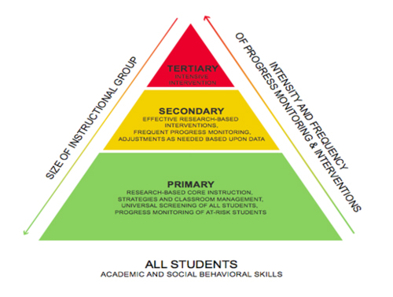
THE RTI MODEL

Slide 14
The Multiple Tiers of RTI: The Team & The Approach
Tier 1 - In consultation with one or two colleagues, teacher applies general, effective instruction strategies. (Core Curriculum, whole class, CHAMPS strategies)
Tier 2 - In consultation with RTI team member(s), teacher tries more targeted evidence-based interventions such as online intervention programs, behavior plans, small groups with modified work, etc. Goal is to close academic gaps by providing strategic intervention a couple times a week.
Tier 3 - Using full team support, teacher and others implement highly intensive, evidence-based interventions such as Positive Behavior Intervention Plan, intense intervention on specifically identified skills. The intensity level will increase. The goals is for the student to make growth with intense daily intervention to close academic gaps.

Slide 15
What is Tier 1?
Tier 1 is the foundation of the RTI Model.
Tier 1 should contain the largest number of students in each class. If Tier 1 is not implemented properly, the number of students in Tier 2 and Tier 3 will rise rapidly campus-wide and/or district-wide.
Powerful classroom instruction begins with the adoption and use of an evidence-based curriculum, but effective teachers do not simply teach such a program page-by-page in the same way for all students. Rather, they differentiate instruction, providing instruction designed to meet the specific needs of students in the class.

Slide 16
Characteristics of Tier 1 Intervention
High quality classroom instruction
Differentiation
Data-driven
Re-teaching and/or tutoring provided when needed
Informal & formal assessment
Individual student progress is compared to whole class progress
Extended learning

Slide 17
TIER 2
TIER 3
Intervention provided in small groups
4-6 students in group
Intervention provided a couple times a week
2-3 times a week for 15-20 minutes
Intervention provided for 4-6 weeks
Progress is monitored & reviewed to determine the effectiveness of intervention
Intervention provided in small groups
1-3 students in group
Intervention provided daily
4-5 times a week for 20-30 minutes
Intervention provided for 4-6 weeks
Progress is monitored & reviewed to determine the effectiveness of intervention plan & need for evaluations

Slide 18
After 6 Weeks of Instruction
STEP 1- What Is The Problem?
To identify a problem, you need to start with three pieces of data:
Expected Level of Performance: what are the expectation of student performance
Student Level of Performance: what is the students actual performance
Peer Level of Performance: how does the student’s current performance compare to their peers
STEP 2- Why Is It Occurring?
Determine/Brainstorm with RTI team member why the student is not demonstrating the expected level of performance/behavior…does the student have gaps in their learning?
Assessment data should be collected to validate your hypothesis; consider multiple data sources: use Data Indicator Spreadsheet.
Review cumulative folder and submit a RTI Referral Form.

Slide 19
STOP & CHECK
When assessment indicates the majority of the class is deficient in any indicator, Tier 1 instruction is tailored to meet the needs of the class.

Slide 20
Begin Intervention & Documentation
STEP 3- Intervention Design
What am I going to do?
Match intervention type and intensity to student, setting and problem
Intervention must focus on teaching replacement behavior
Complete observations of student behavior
Ensure first RTI meeting is scheduled
First RTI Meeting
Bring the RTI Referral & your intervention design plan to the first RTI meeting
Monitor student progress with interventions for 4-6 weeks
Complete RTI Meeting Summary in Eduphoria & send copy home to parents
Document interventions and student progress on Intervention Log until the next RTI meeting

Slide 21
Review Progress-Follow Up RTI Meeting
Ensure follow up RTI meeting is schedule and gather needed documents for meeting
Intervention Log
Test scores
Grades
Class work
Etc.
Ensure parents are communicated with regularly about their child’s intervention plan and progress
RTI Team will review student progress and consider some of the following options:
move the student up or down a tier
brainstorm additional interventions
make decision on testing. If the committee does not feel that full-educational testing needs to occur, then additional interventions will be generated.
Complete RTI Meeting Summary in Eduphoria & send copy home to parents
Document interventions and student progress on Intervention Log until the next RTI meeting

Slide 22
During RTI Meetings the Team Should….
Targeting the problem
Analyzing the problem
Brainstorming alternative solutions
Launching an intervention with fidelity
Evaluating the effects of the intervention

Slide 23
Progress Monitoring

Slide 24
Is it working??
DATA, DATA, DATA
Data should include measurements of student progress throughout the intervention progress
Specific student progress of an intervention/skill must be based on the specific intervention skill (ex. a 6 week assessment is not a progress measurement tool for a specific intervention/skill because it is not specific and assess many different skills)
Progress monitoring is documented on the Intervention Log (documentation is required but this log is not a mandatory form-your campus can use another similar tool to document intervention & measure student growth).

Slide 25
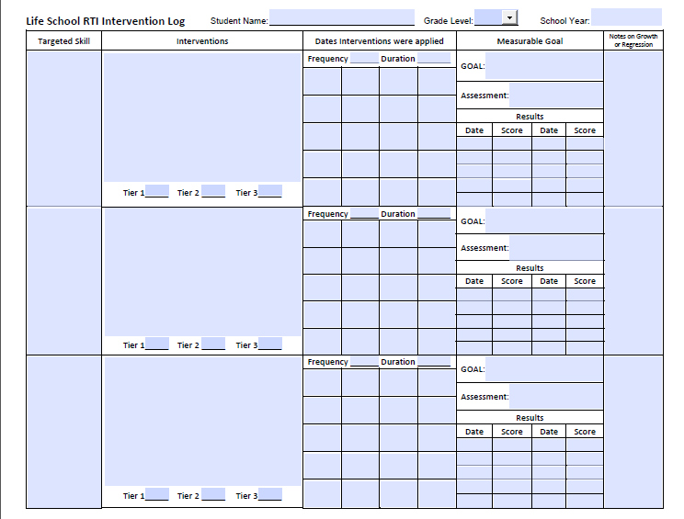
Specific Intervention
Specific Skill
List all dates of intervention
Your expectation, where you want student to be (should never be 100%)
Assessment Tool Used
Date & Score of Each Assessment
Notes-BE CAREFUL what you write here

Slide 26
Entering the Data

Slide 27
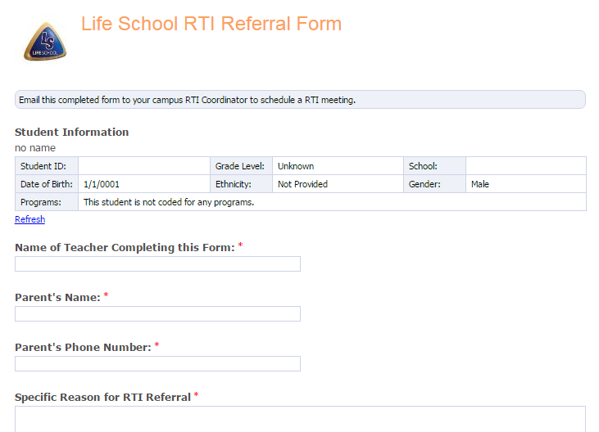
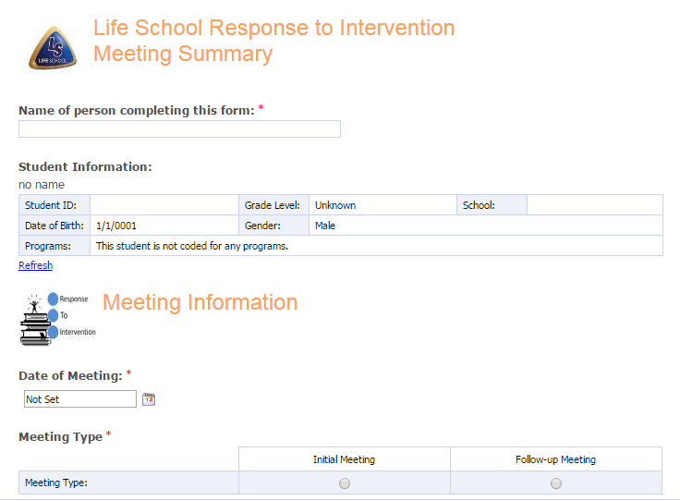
Forms Available in Eduphoria
RTI Referral Form
RTI Meeting Summary

Slide 28
Additional Forms on the Extranet:
RTI Flowchart
RTI Parent Notification Letter
Intervention Log
Instructions on how to assign forms in Eduphoria

Slide 29
Data Sources

Slide 30

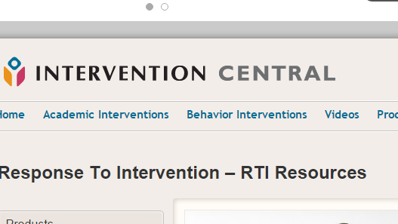





Slide 31
Getting Started

Slide 32
Campus Leadership
Teachers
Determine who will be your campus RTI coordinator:
Who is responsible for getting the RTI referrals & scheduling a meeting?
Define your RTI Team for each tiered level:
Who should be involved in Tier 2 RTI meetings and Tier 3 RTI meetings?
Determine what day(s) you will hole RTI meetings:
What days will RTI meetings be held each month?
Determine who will train your staff & when the training will be.
Conduct quick checks throughout the year to ensure intervention is happening on your campus and documentation is being updated in Eduphoria.
Determine students in need of intervention:
Use RTI Indicator Spreadsheet
Submit RTI Referrals for students in need of intervention
Ensure RTI meeting is held for student(s)
Implement intervention plans for students on Tier 2 & Tier 3, as determined in the RTI meeting
Document student progress
Communicate with parents regularly…make sure they are informed of their child’s RTI plan & progress/growth

Slide 33
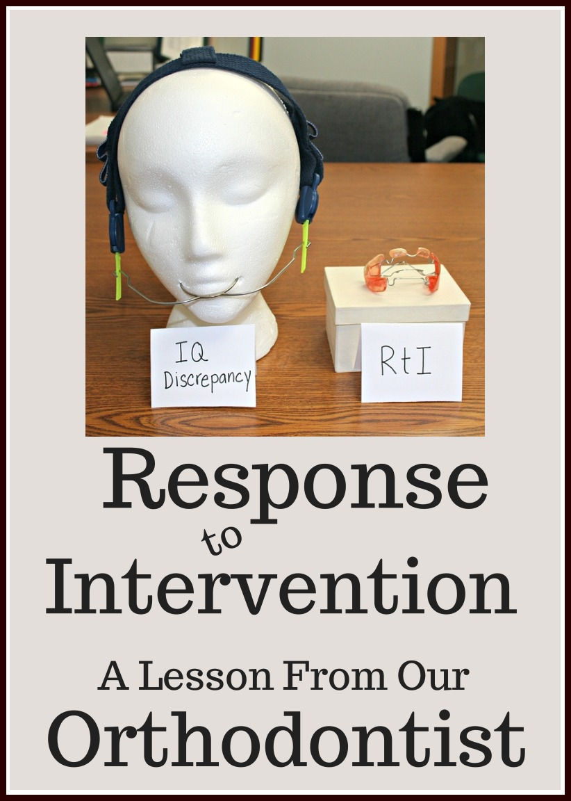
Aren’t you glad your dentist uses RTI?!?

Slide 34

Teamwork & Collaboration are KEY!

